Slide 1
Kernel Machines

Slide 2
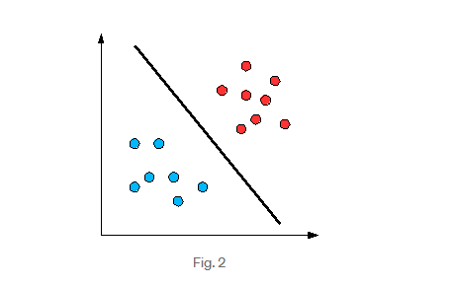
Linearly Separable

Slide 3
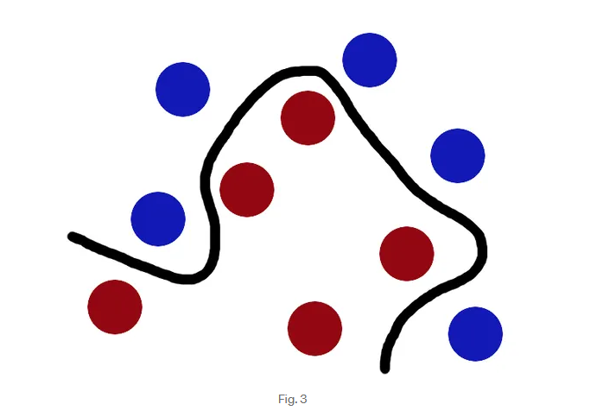
Linearly Inseparable

Slide 4
What is Kernel
“kernel” refers to the kernel trick.
A method of using a linear classifier to solve a non-linear problem.
It transforms linearly inseparable data to linearly separable ones.
The kernel function is applied on each data instance to map the original non-linear observations into a higher-dimensional space in which they become separable.

Slide 5
What is Kernel
Mathematical definition: K(x, y) = <f(x), f(y)>. Here K is the kernel function, x, y are n dimensional inputs.
f is a map from n-dimension to m-dimension space. < x,y> denotes the dot product. usually m is much larger than n.
calculating <f(x), f(y)> requires us to calculate f(x), f(y) first, and then do the dot product.
These two computation steps can be quite expensive as they involve manipulations in m dimensional space, where m can be a large number.

Slide 6
But after all the trouble of going to the high dimensional space, the result of the dot product is really a scalar: we come back to one-dimensional space again!
do we really have to go to the m-dimensional space? The answer is no, if you find a clever kernel.

Slide 7
Example
Simple Example: x = (x1, x2, x3); y = (y1, y2, y3). Then for the function f(x) = (x1x1, x1x2, x1x3, x2x1, x2x2, x2x3, x3x1, x3x2, x3x3), the kernel is K(x, y ) = (<x, y>)².
Let’s plug in some numbers to make this more intuitive: suppose x = (1, 2, 3); y = (4, 5, 6). Then:
f(x) = (1, 2, 3, 2, 4, 6, 3, 6, 9)
f(y) = (16, 20, 24, 20, 25, 30, 24, 30, 36)
<f(x), f(y)> = 16 + 40 + 72 + 40 + 100+ 180 + 72 + 180 + 324 = 1024

Slide 8
A lot of algebra, mainly because f is a mapping from 3-dimensional to 9-dimensional space.
Now let us use the kernel instead:
K(x, y) = (4 + 10 + 18 ) ^2 = 32² = 1024
Same result, but this calculation is so much easier.

Slide 9
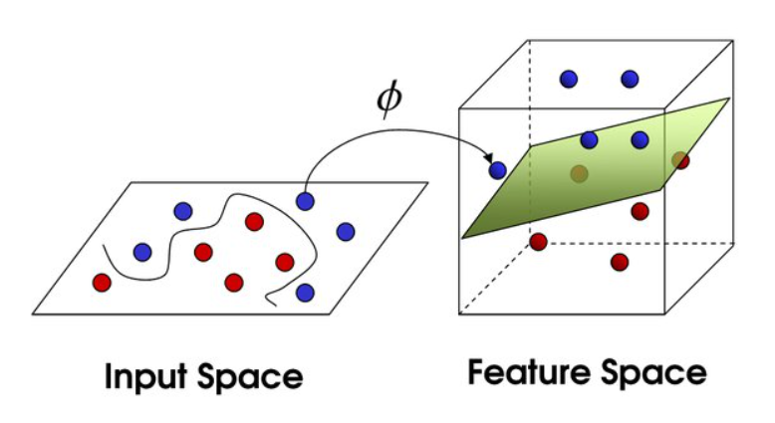
Example: SVM

Slide 10
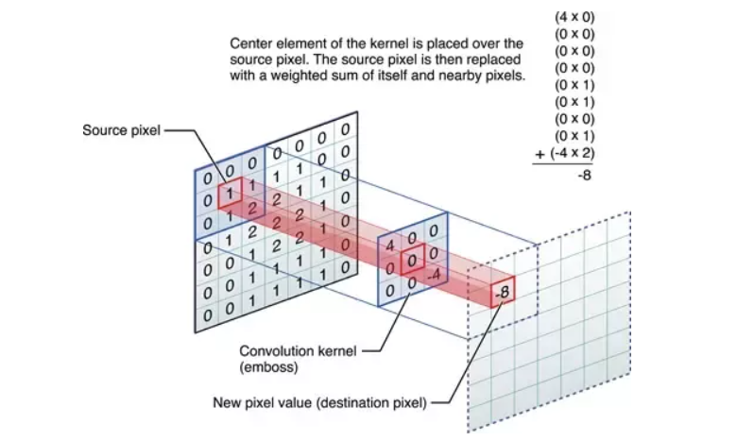
Example: Deep Learning - CNN

Slide 11
A kernel in a CNN is basically a small window (of say 3 x 3 pixels), that has specific values.
This small window is applied to an input image to obtain a specific result, through a mathematical process called convolution.
The kernel is ‘slid’ across the original image, commonly one pixel at a time, to calculate the pixel response of that particular pixel.

Slide 12
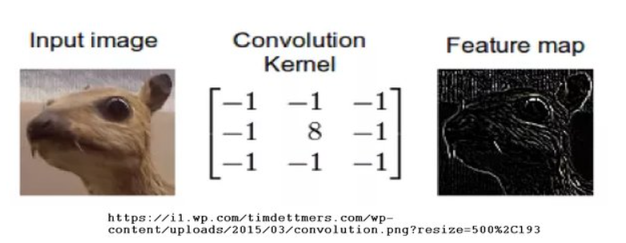
This is an edge detection kernel (kernels are also called filters in the image processing world). The response (output image) is shown as the feature map (which is also the term commonly used when talking about CNNs).

Slide 13
Commonly used kernel functions
Linear Kernel
Polynomial Kernel
Gaussian Kernel
Sigmoid Kernel
Convolution Kernel
Pooling Kernel
Activation Function (ReLU)

Slide 14
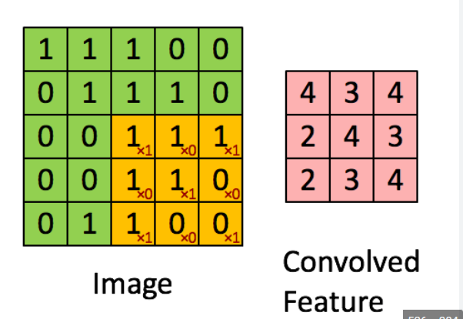
Convolution Layer in CNN using Kernel/Filter

Slide 15
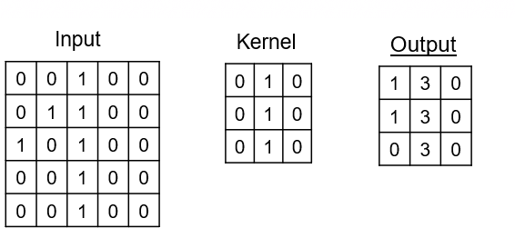

Slide 16
